Slide 1

MCBIOS 2018: Career development workshop for young scientists
Inimary Toby, PhD
March 30, 2018
The Mill Conference Center, Starkville, MS
Room: Delta Theatre
Time: 1:30-3:15pm

Slide 2

Goals and Objectives for the workshop
1) To present trainees with a breadth of career-related resources
2) To provide a framework for career trajectory and planning activities
3) To complete career exploratory tasks using media and live discussions
4) To assist trainees in creating an individualized career development plan (IDP)

Slide 3
Introduction: goals, objectives, trends in bioinformatics
Career profiles and creating your individualized development plan
Summary, Q&A and evaluations
10 mins
10 mins
30 mins
40 mins
20-25 mins
Toolkits and career-related resources
2 Hands-on exercises: case studies for project management and scientific writing

Slide 4

Discussion Points for Workshop
Career–related resources
Examining current trends in Bioinformatics
Online communities and professional affiliations
Careers in Academia and Non-Academia
Career profiling
Individual development plan
Creating a toolkit
Hands-on Exercises
Case studies looking at project management and scientific writing

Slide 5
Career-related resources

Slide 6
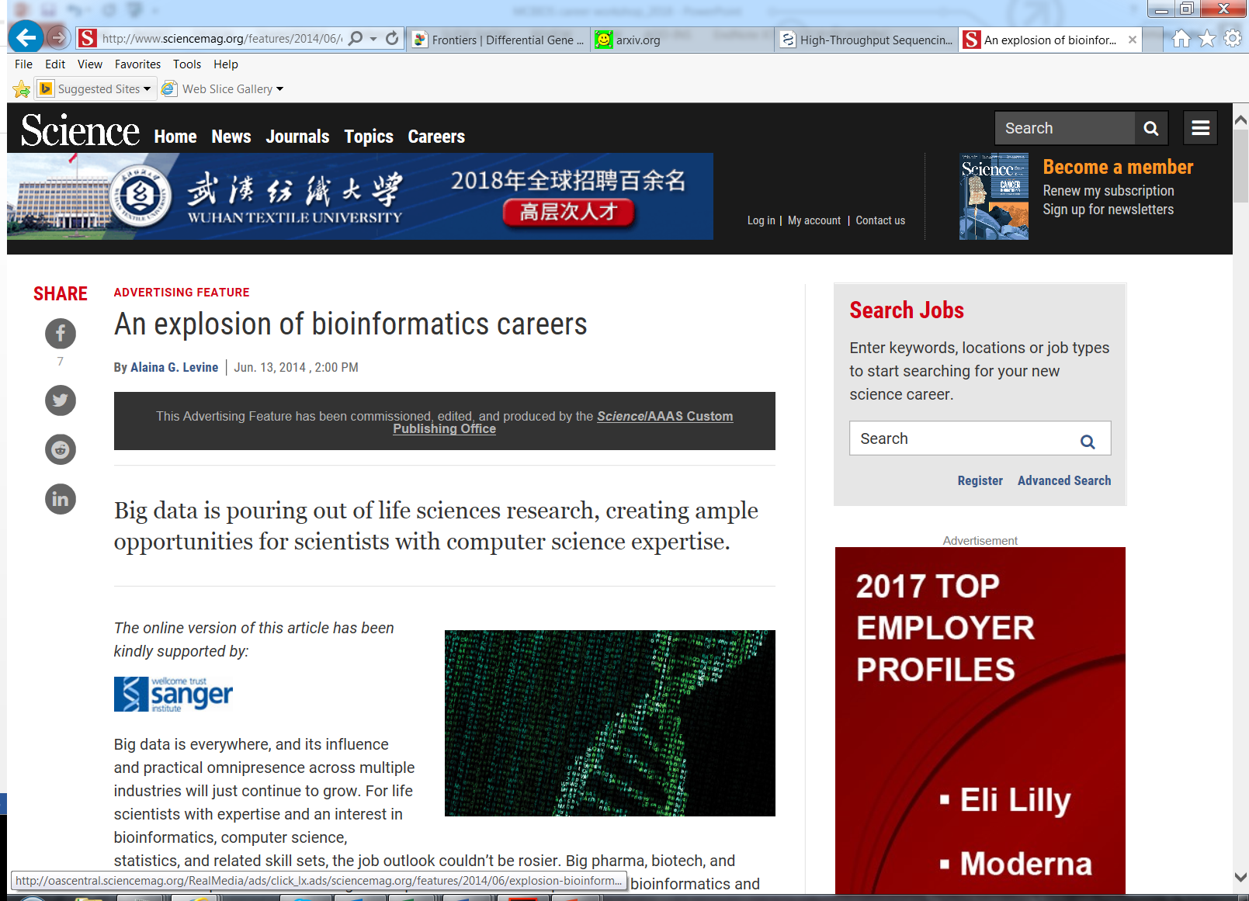
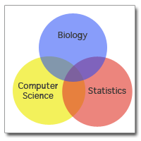
Examining trends in Bioinformatics
AAAS, 2014

Slide 7
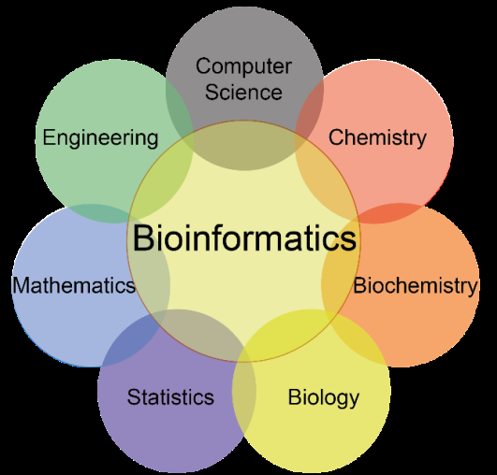
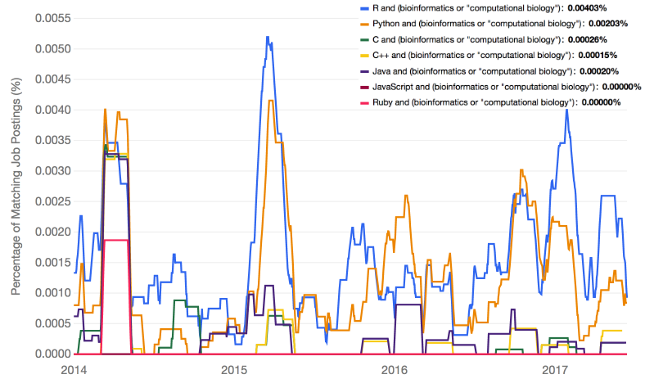
Trends in Bioinformatics
Indeed.com
Bioinformaticscareerguide.com

Slide 8
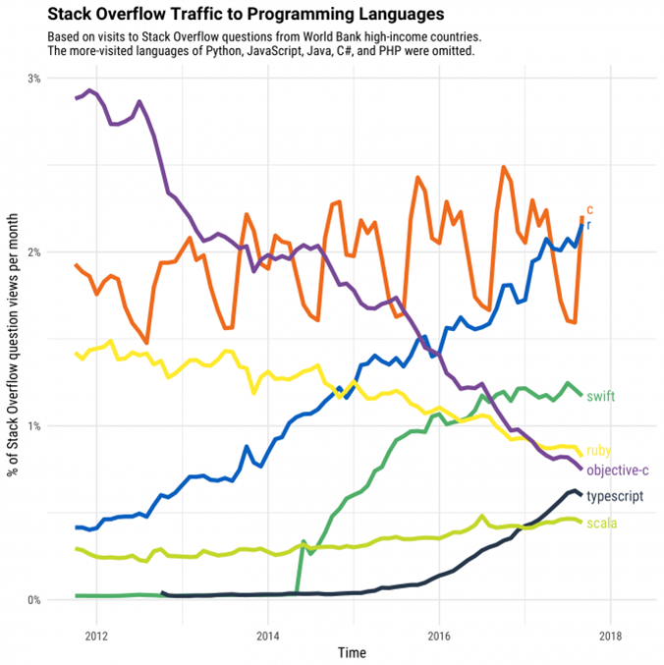
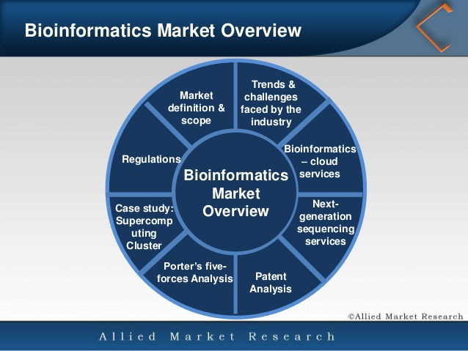
Trends in Bioinformatics
Bioinformaticscareerguide.com

Slide 9
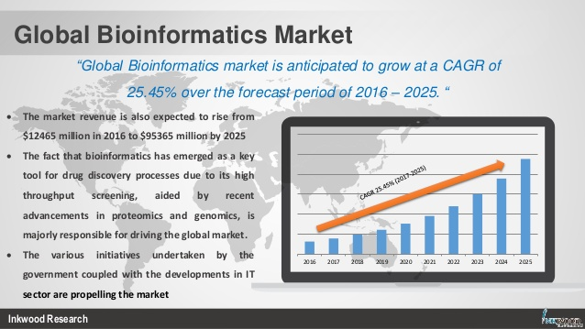
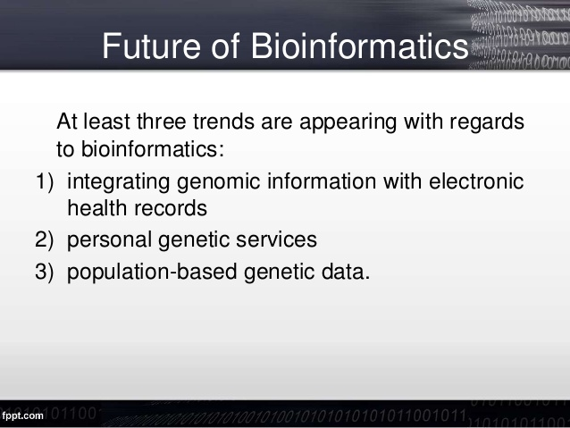
Trends in Bioinformatics
https://www.slideshare.net/sherrythomas13/bioinformatics-market-global-industry-trends-analysis-revenue-report-20172025
https://www.slideshare.net/SealingOnlyYours/bioinformatics-33211564

Slide 10
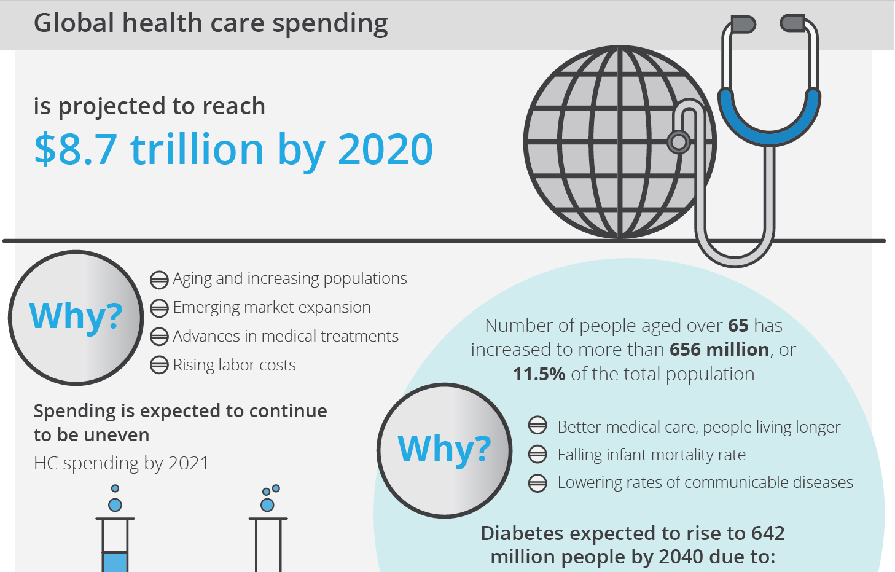
Global Trends
https://www2.deloitte.com/content/dam/Deloitte/global/Images/infographics/lifesciences-healthcare/lshc-2018-global-lifescience-outlook-infographic.pdf

Slide 11
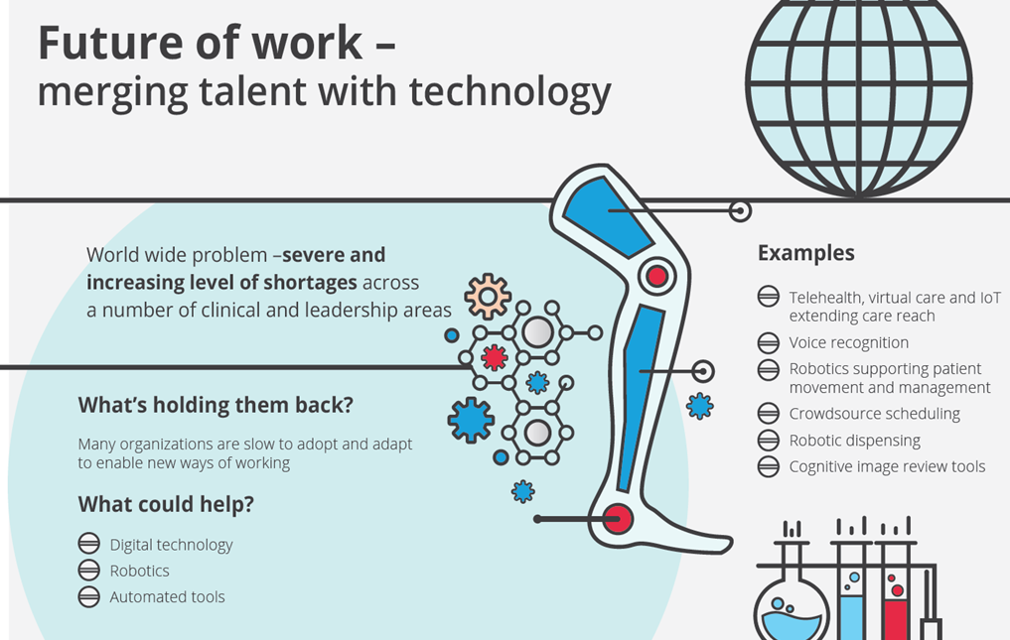
Global Trends
https://www2.deloitte.com/content/dam/Deloitte/global/Images/infographics/lifesciences-healthcare/lshc-2018-global-lifescience-outlook-infographic.pdf

Slide 12
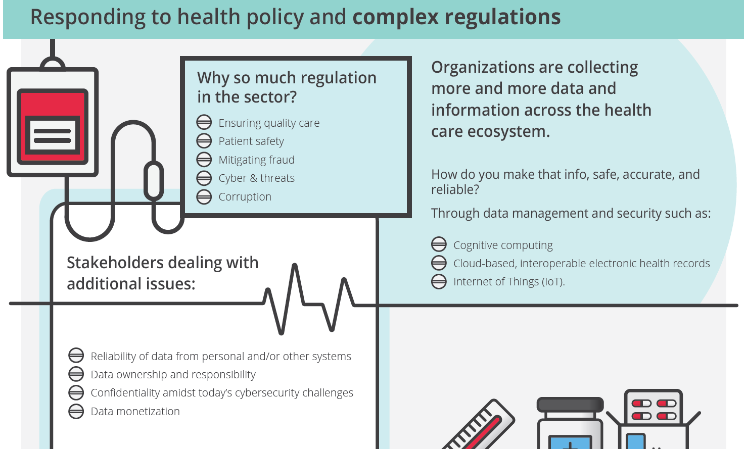
Global Trends
https://www2.deloitte.com/content/dam/Deloitte/global/Images/infographics/lifesciences-healthcare/lshc-2018-global-lifescience-outlook-infographic.pdf

Slide 13
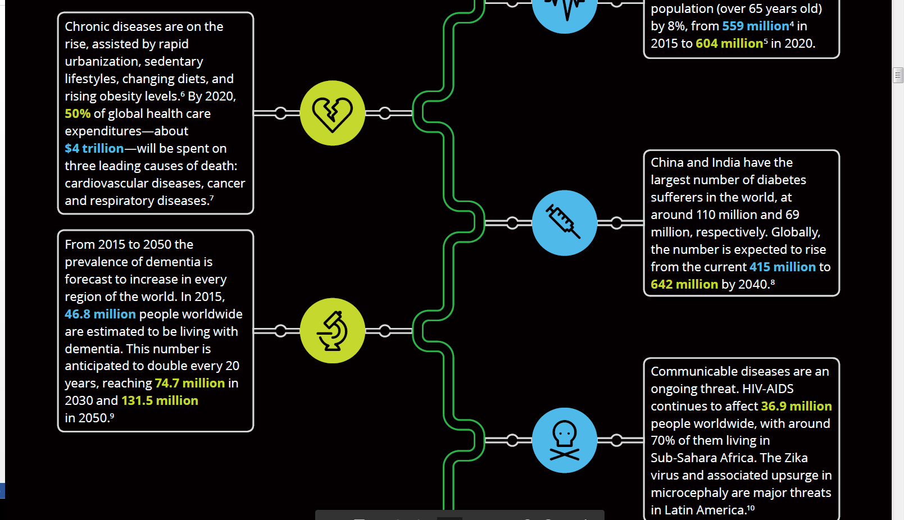
Global Trends
https://www2.deloitte.com/content/dam/Deloitte/global/Documents/Life-Sciences-Health-Care/gx-lshc-2017-life-sciences-outlook.pdf

Slide 14
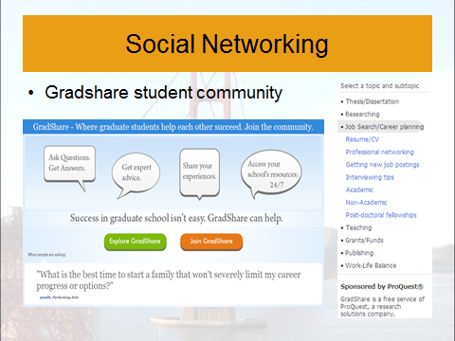
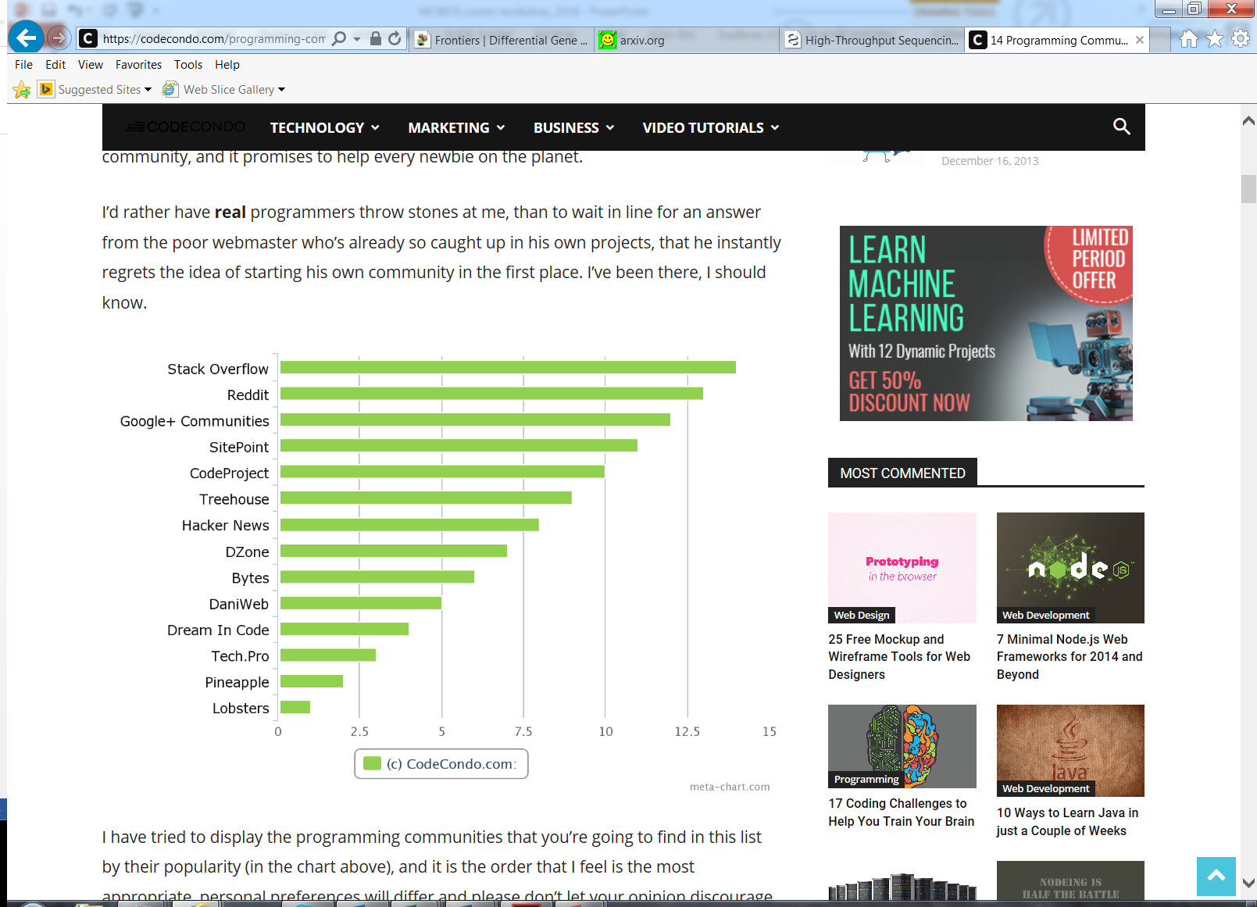
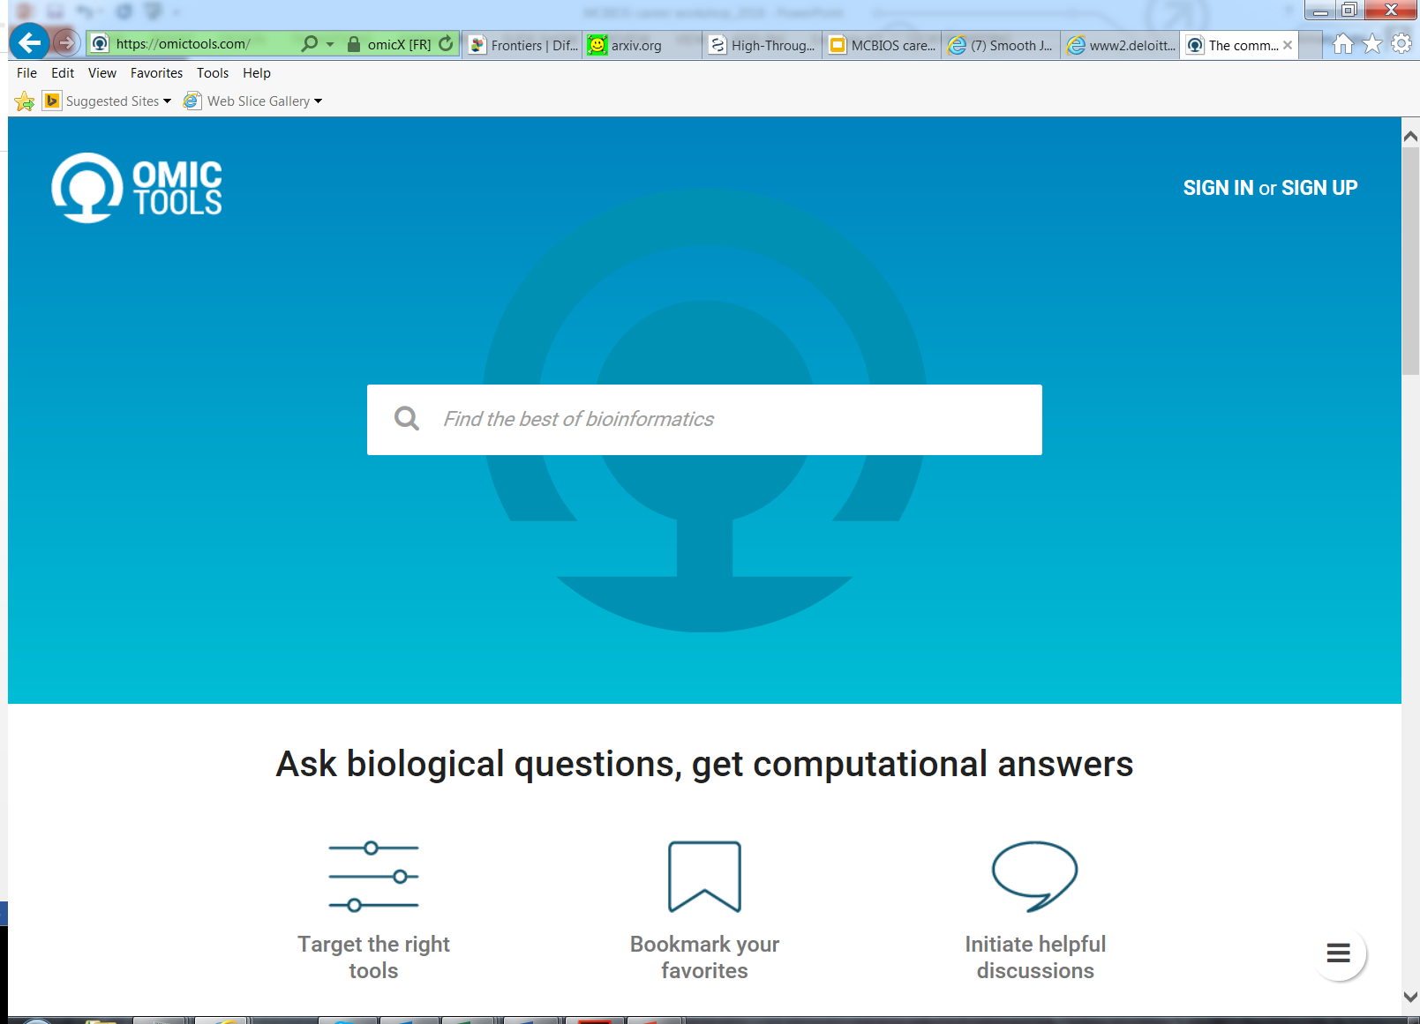
Online communities
http://www.careercornerstone.org/biology/bioprofassn.htm

Slide 15
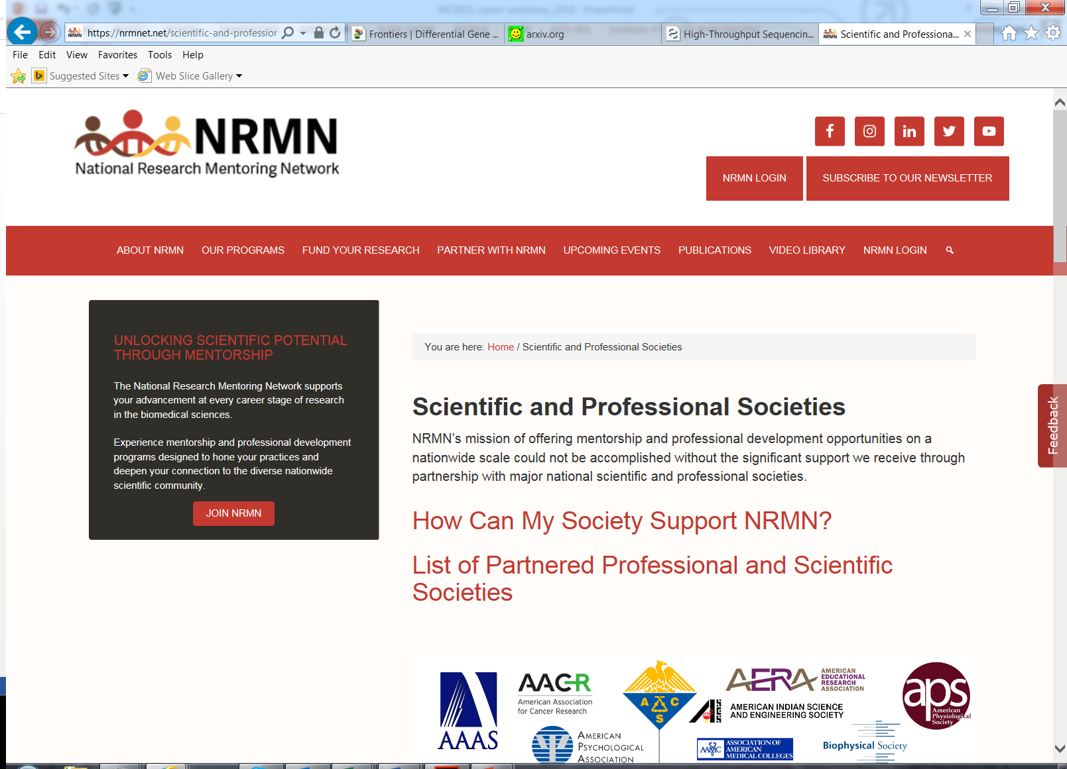
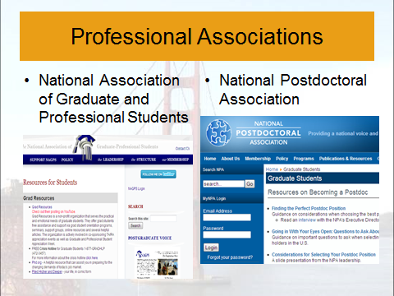
Professional Affiliations: leveraging multiple avenues

Slide 16
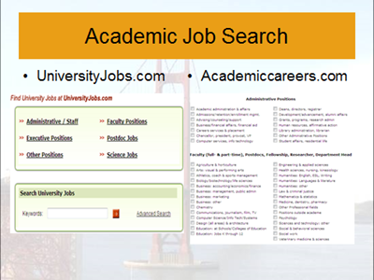
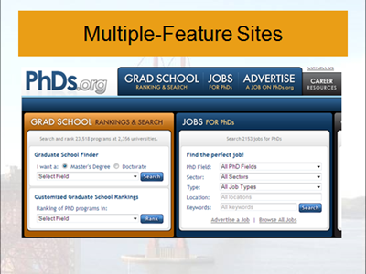
Careers in Academia

Slide 17
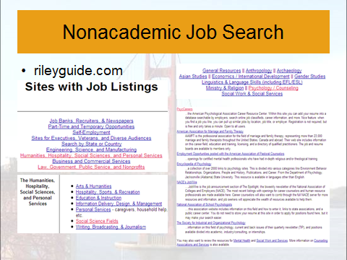
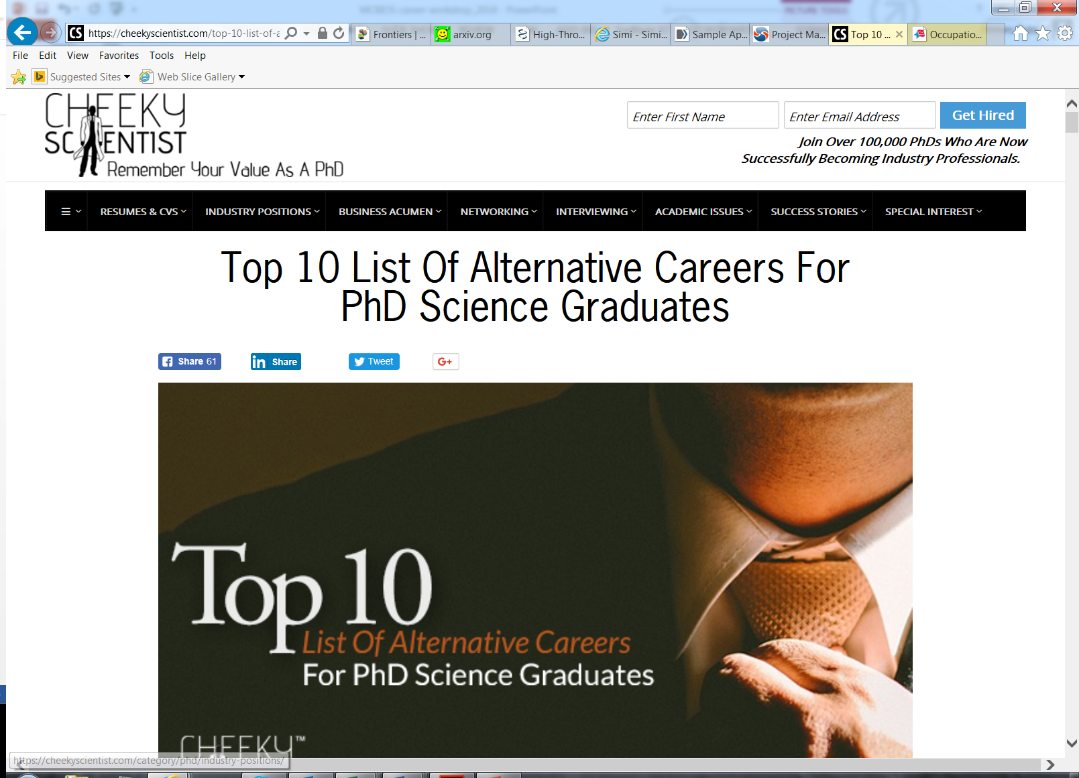
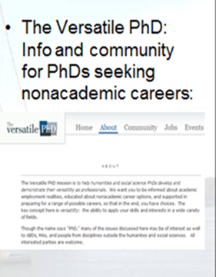
Non-Academic careers
Cheekyscientist.com
Indeed.com
Careerbuilder.com

Slide 18
Summary: Career-related resources
It is important to examine trends and understand the shifts in market for research (and also for your specific areas of focus).
There are multiple online communities and resources available for networking and career development
It is important to leverage the opportunities offered by multiple professional organizations
Non-academic careers are widely available in Bioinformatics and computational sciences as are academic careers
Considerations are important for identification of appropriate career resources for bachelors, masters and PhD level individuals

Slide 19
Career Profiling (videos and discussions)

Slide 20
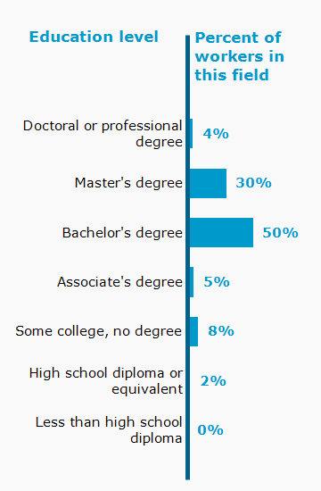
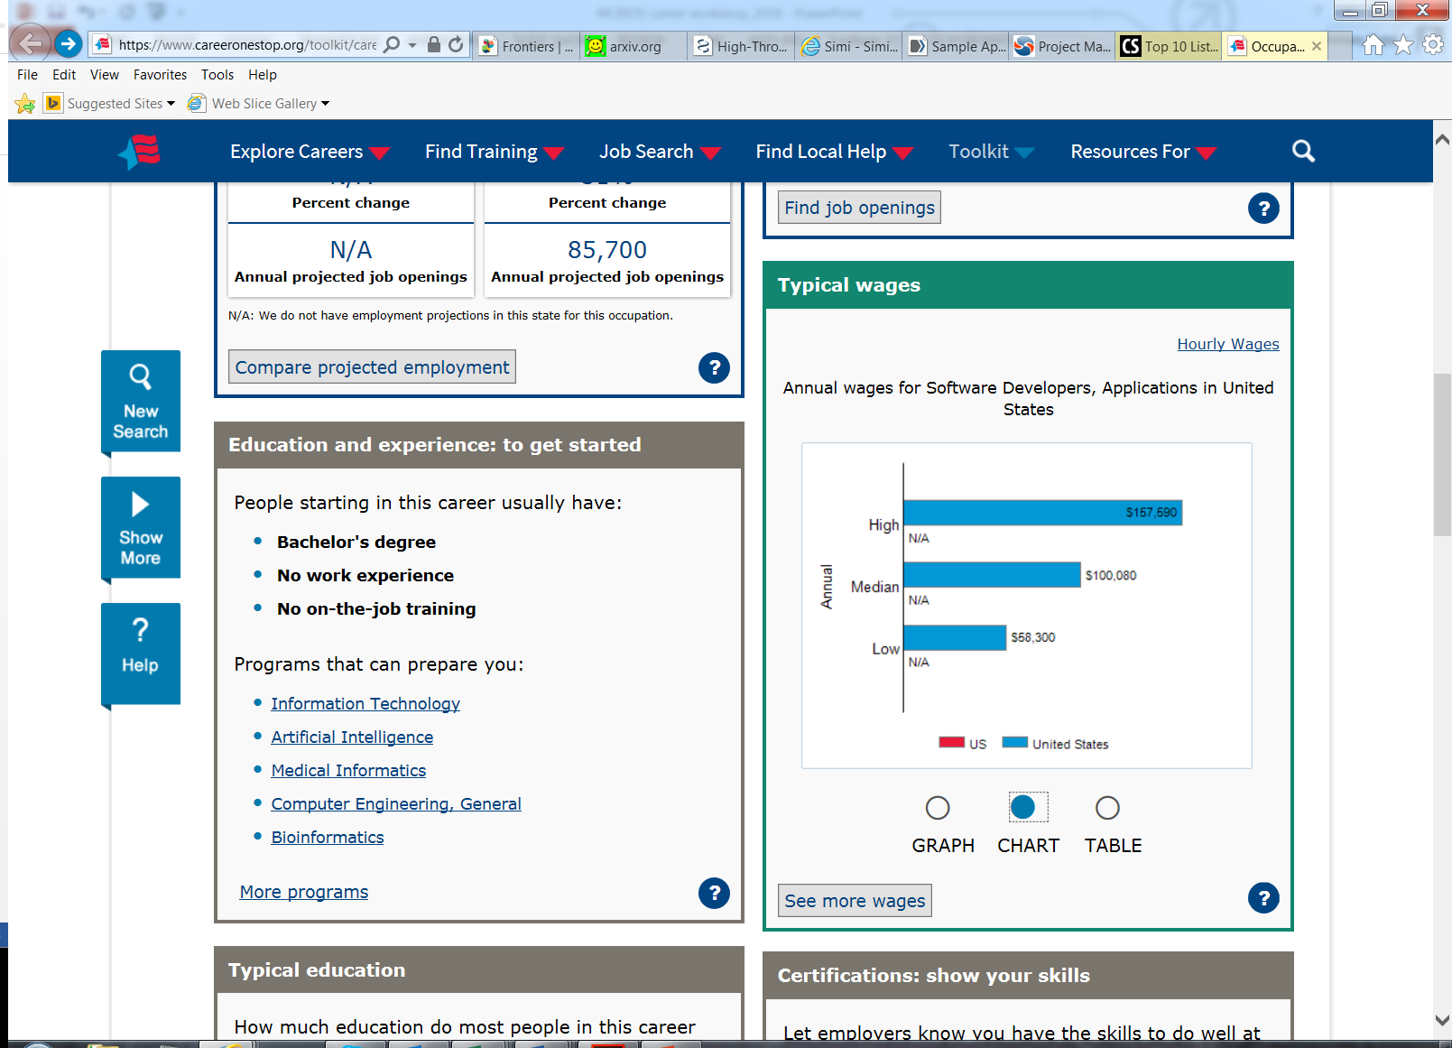
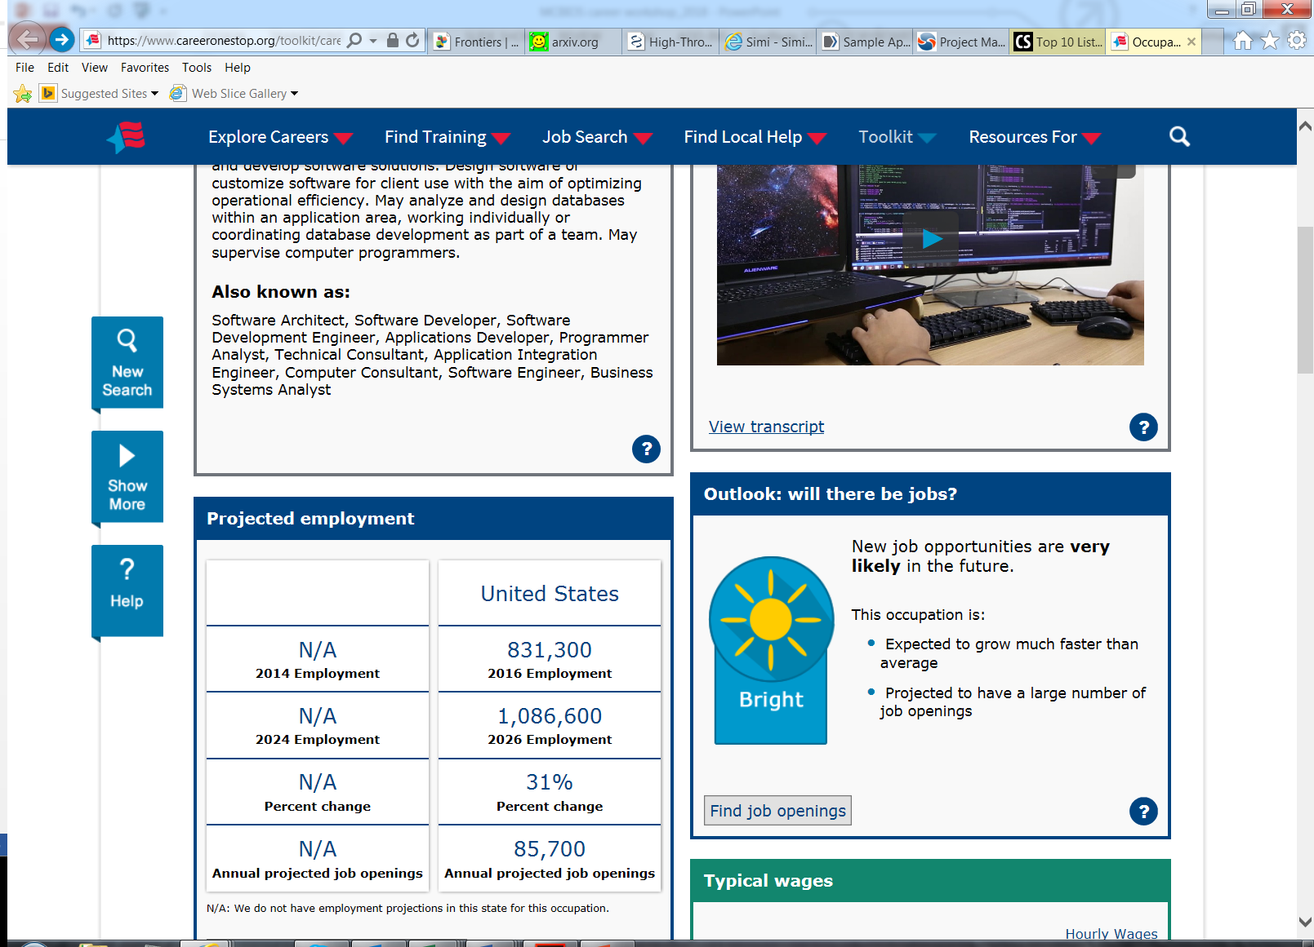
Career profile: Software Developer
https://www.careeronestop.org/toolkit/careers/occupations/occupation-profile.aspx?keyword=Software%20Developers,%20Applications&onetcode=15113200&location=&lang=en
https://www.youtube.com/watch?v=zMZTSw25pf0
https://www.youtube.com/watch?v=gRuAn73yNQM

Slide 21
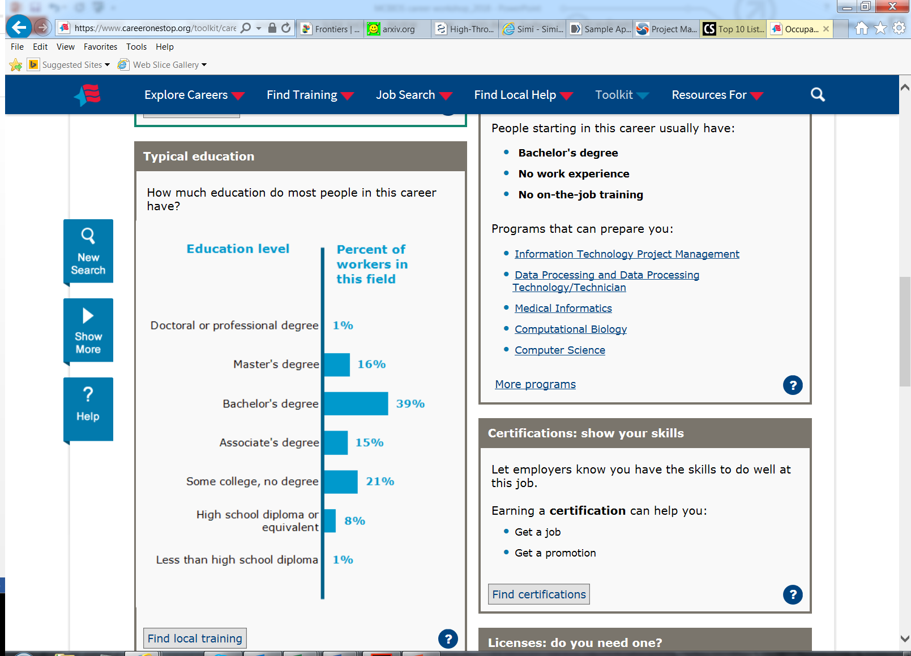
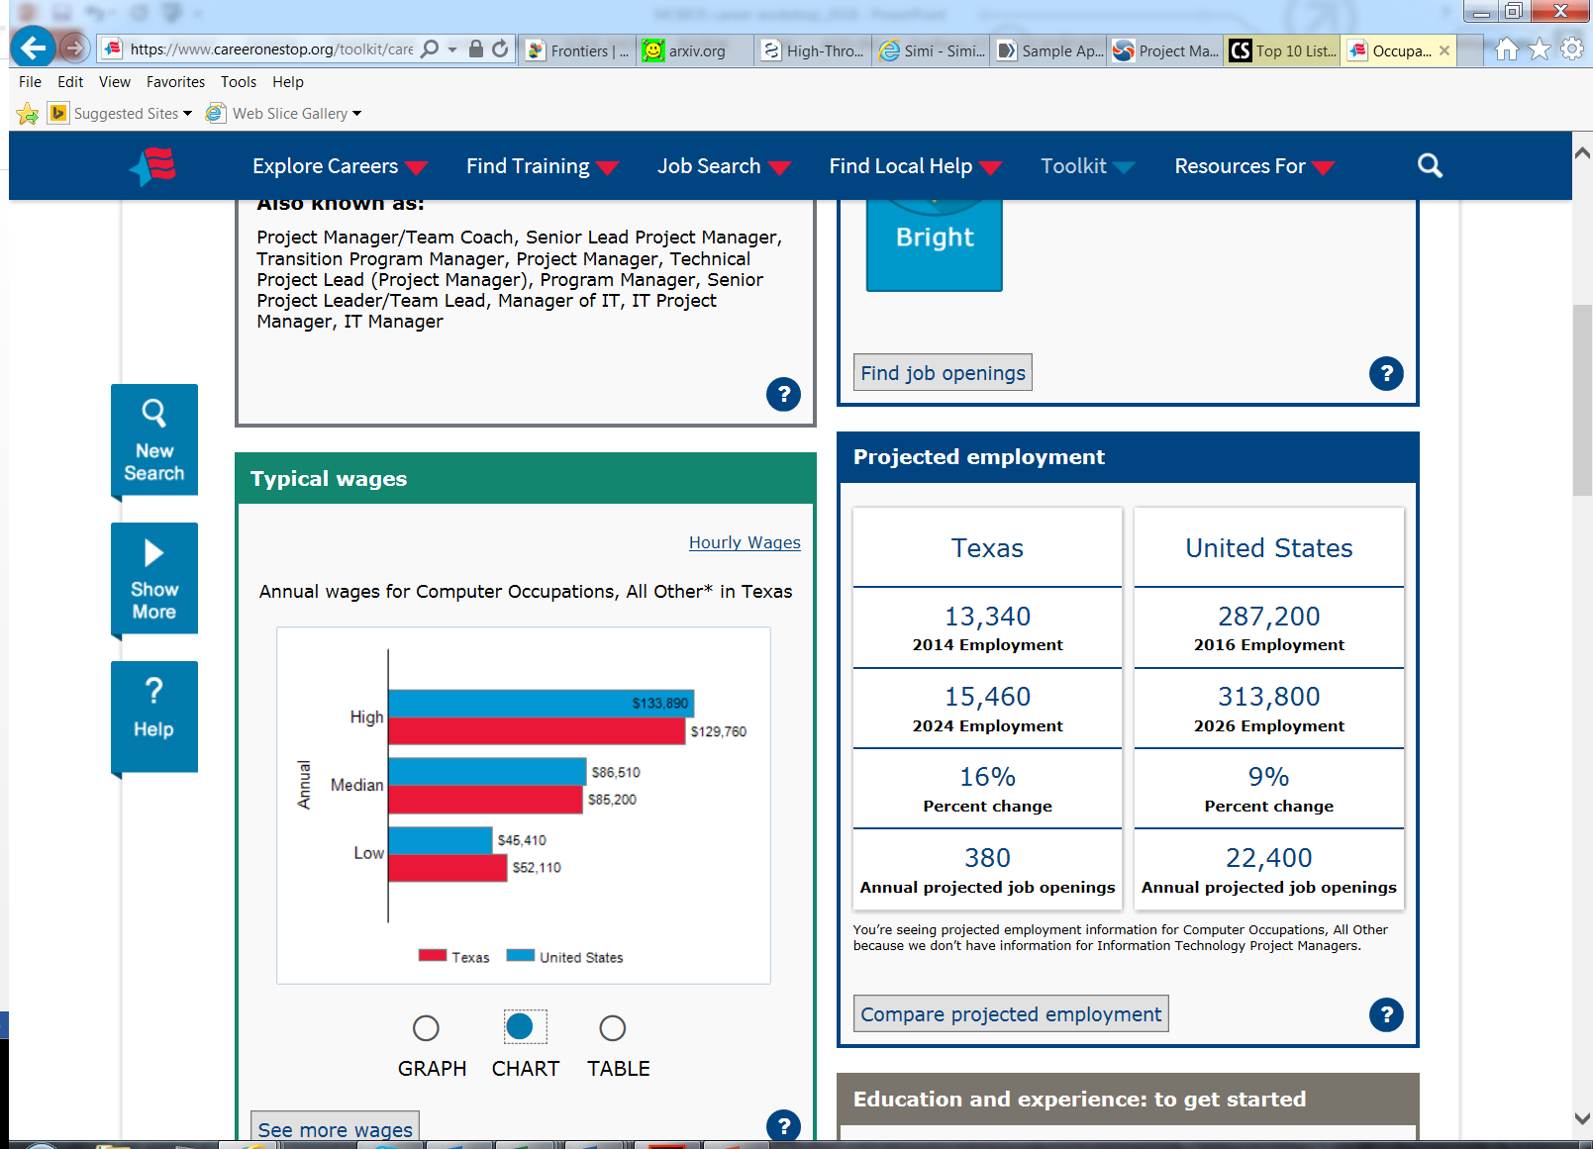
Career profile: Project Manager
https://www.youtube.com/watch?v=WngnAyhQ7bc
https://www.youtube.com/watch?v=4CfUVG4VZoE

Slide 22
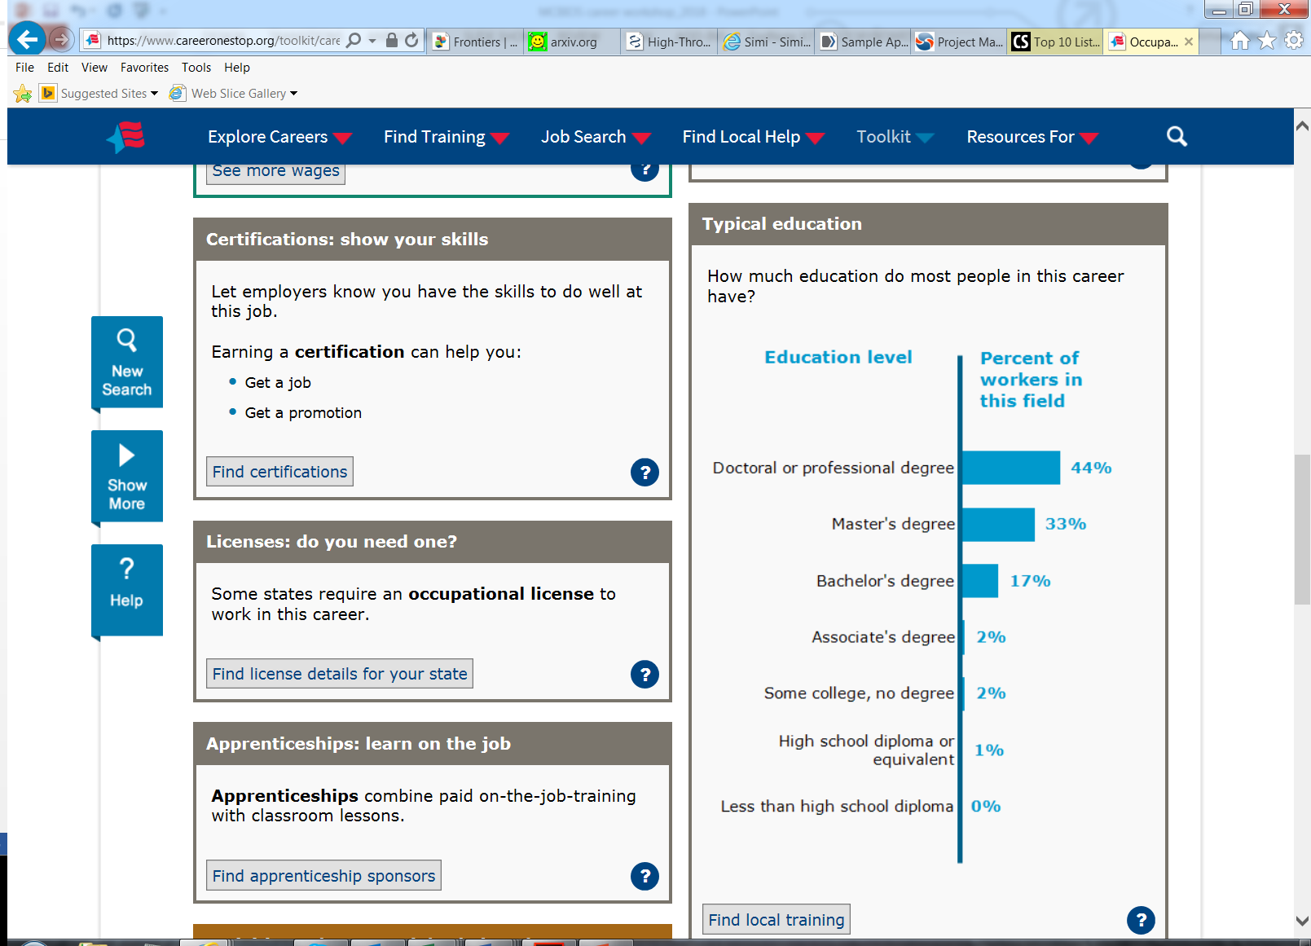
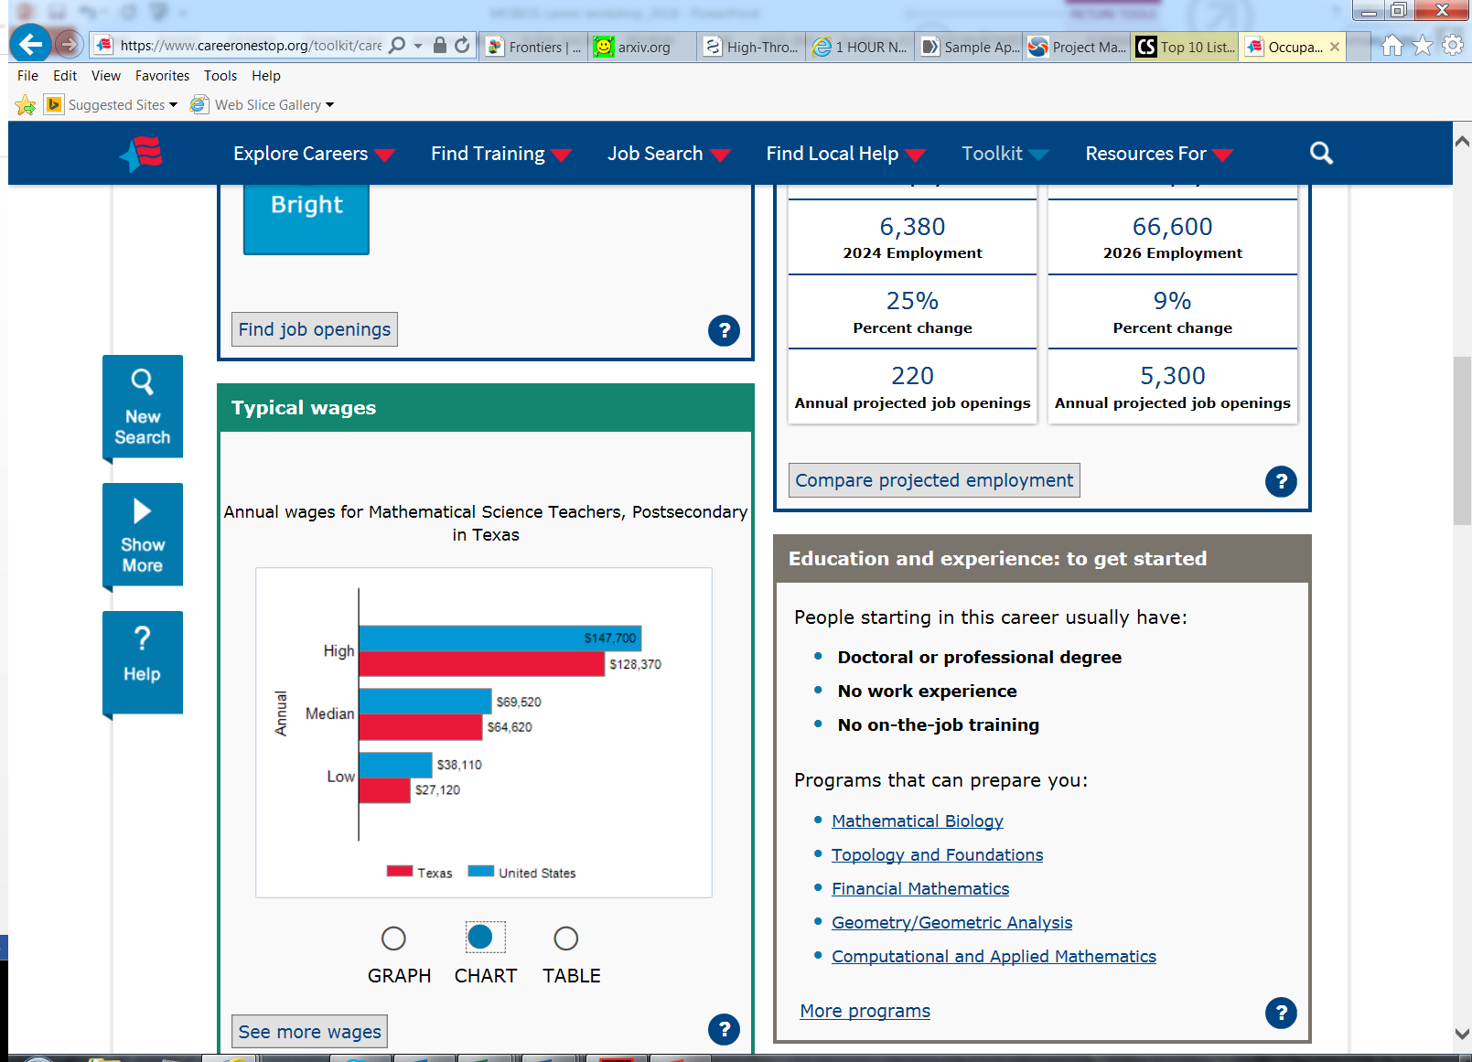
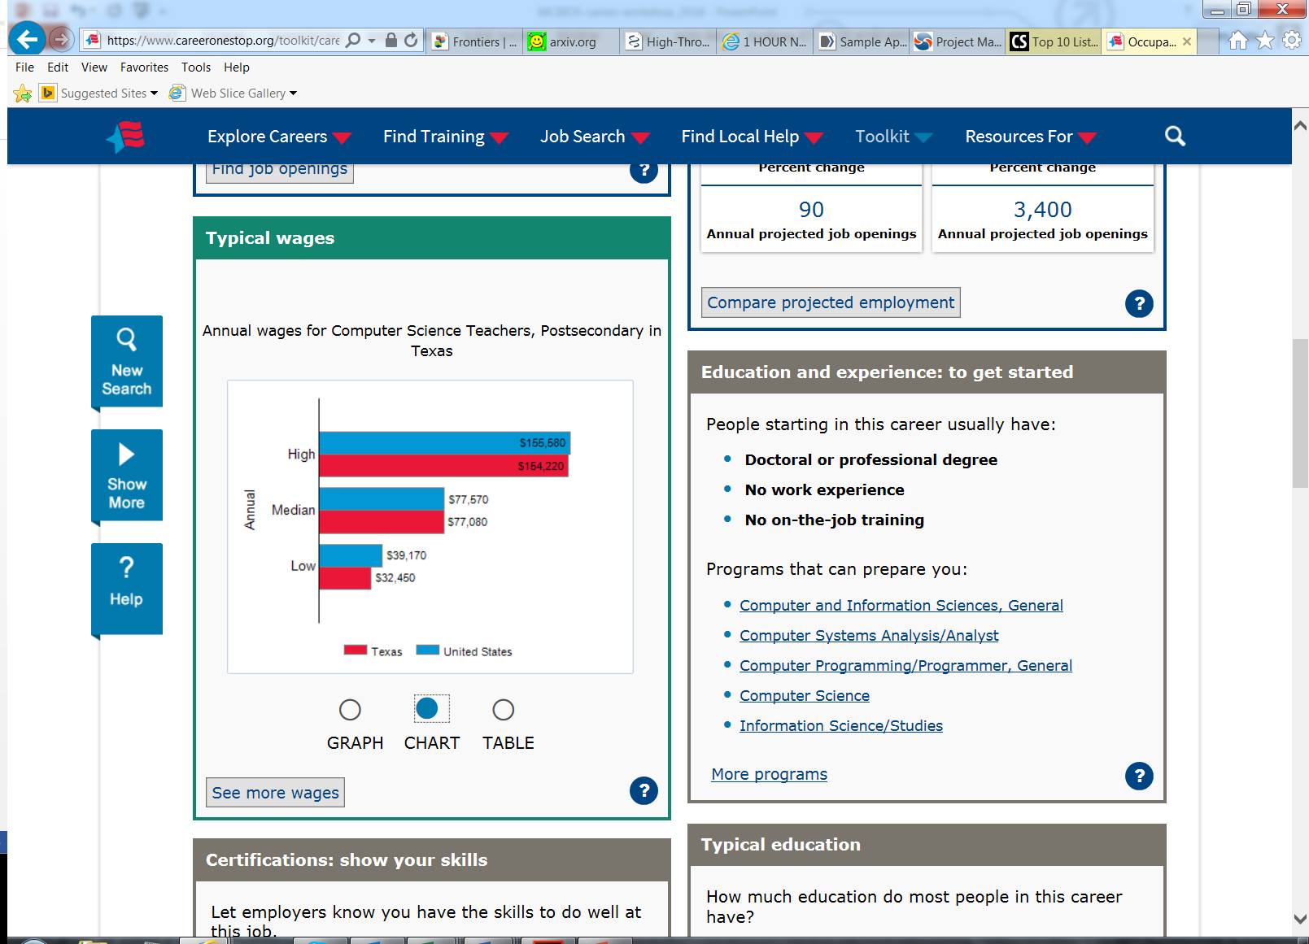
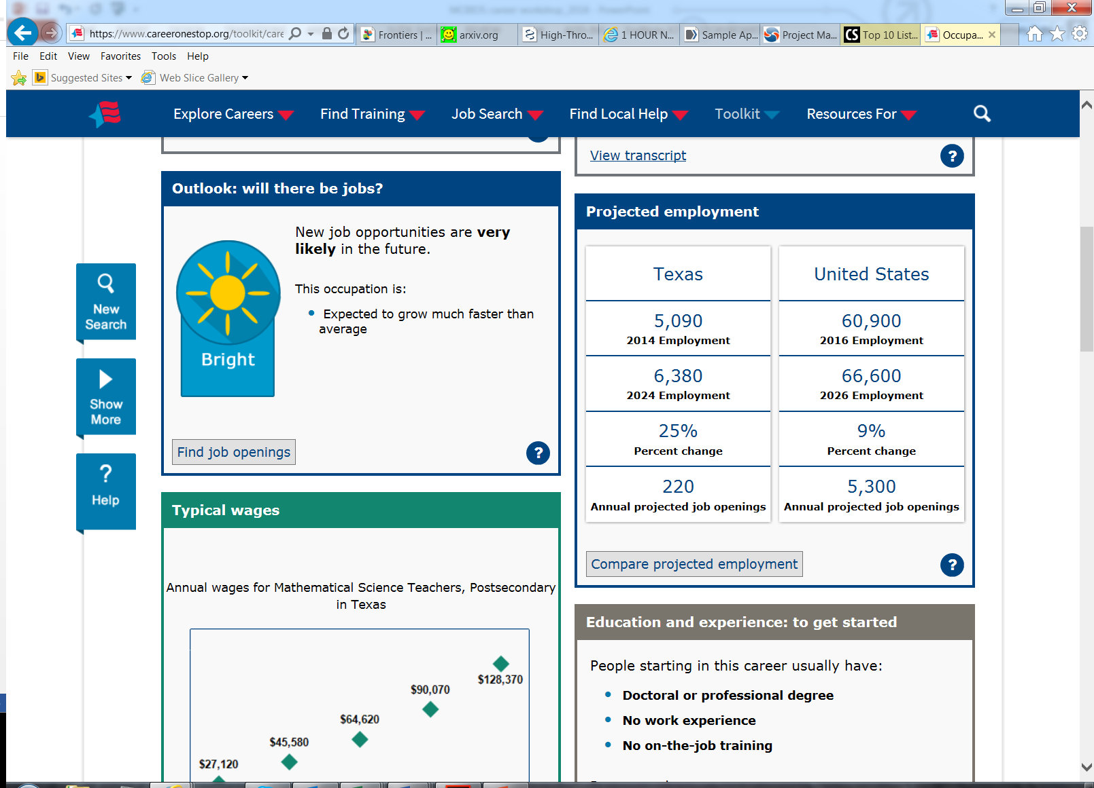
Career profile: Instructor at teaching-intensive institution
https://www.youtube.com/watch?v=yCHQwKQ4M7w

Slide 23
Summary: Career profiling
A brief look at the following career profiles: Project manager, Software developer, and Instructor at teaching-intensive institution helped us understand some of the differences in day-to-day tasks involved in their positions.
Each career role has its own unique set of considerations that should be thoroughly assessed before one embarks on the given path.
Labor statistics provide a mirror into the future outlook of the occupation, sectors, and positions.

Slide 24

Individual Development Plan (IDP)

Slide 25
Creating your personal portfolio
Identify the following:
Strength 1: examples:
Strength 2: examples:
Strength 3: examples:
Growth area 1: examples:
Growth area 2: examples:
Growth area 3: examples:
What types of career roles could you achieve by improvement of your growth areas?
What types of career roles fit within your strengths?
Project manager, Principal investigator, Lab manager, Instructor

Slide 26
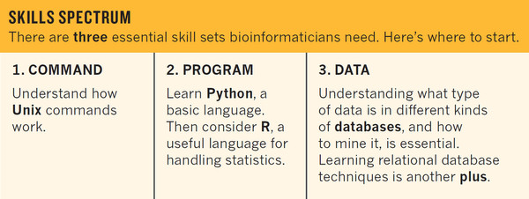
Creating a toolkit
What is your market (field or area of expertise)?
What is your strategy to succeed in this market?
What tools are needed to accomplish this?

Slide 27
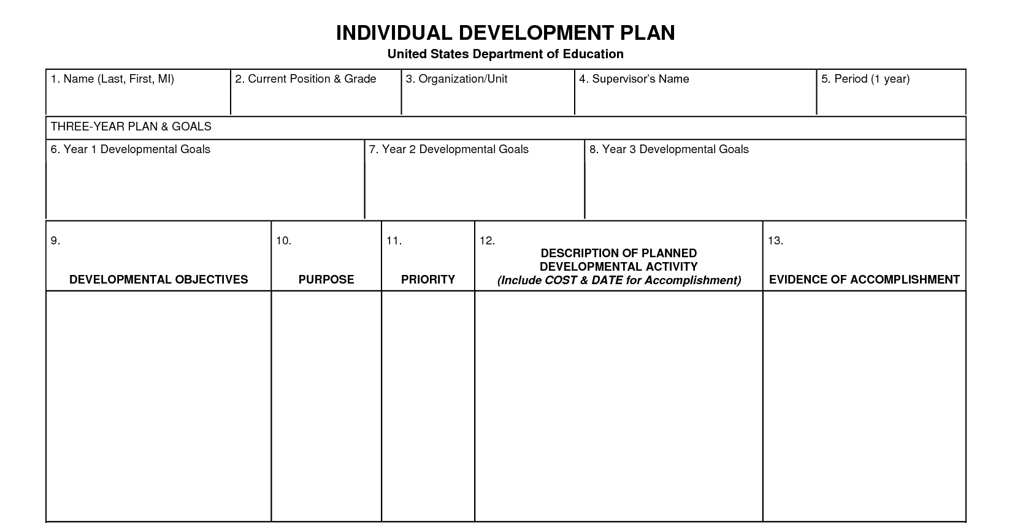
Template to use for your IDP (option 1)

Slide 28
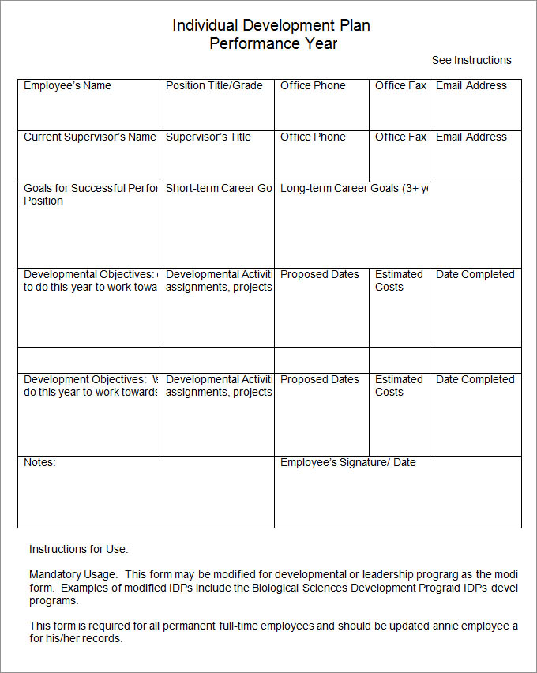
Template to use for your IDP (option 2)

Slide 29
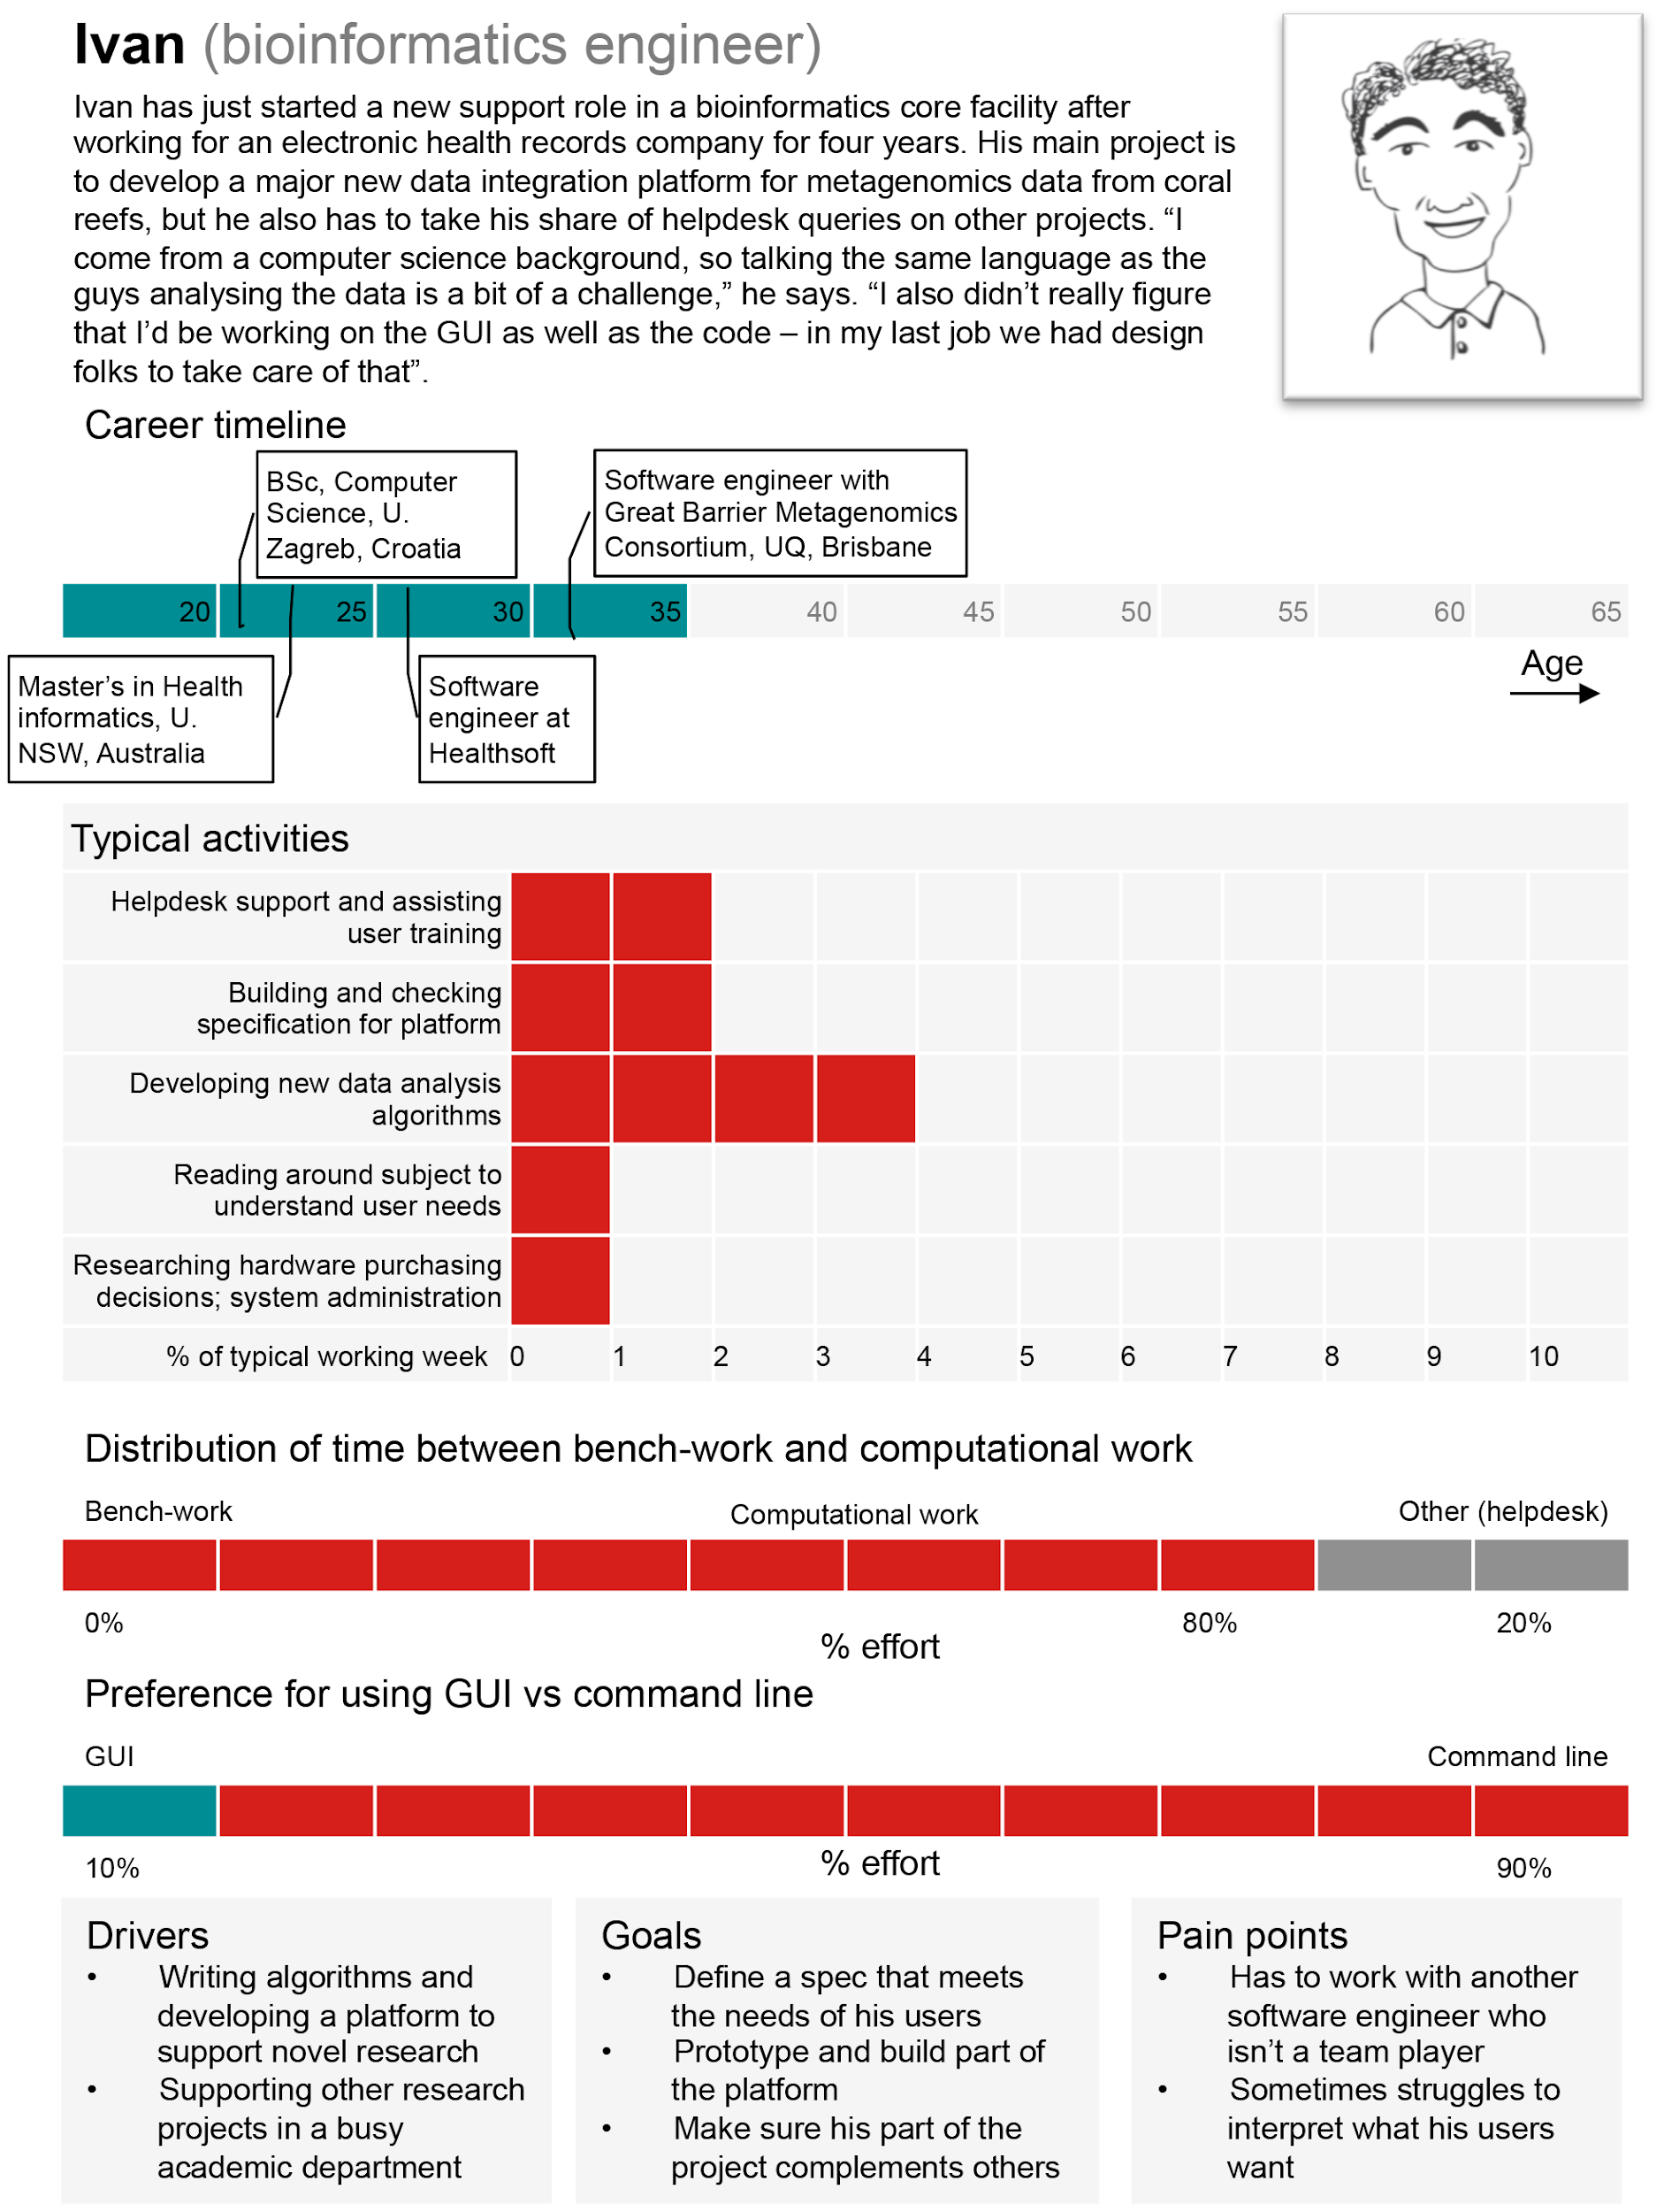
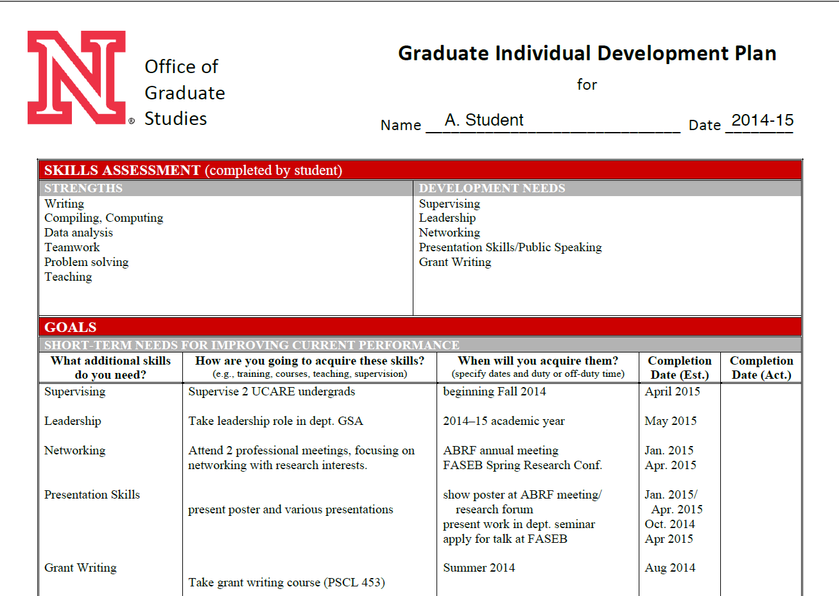
Example IDPs

Slide 30
Develop your IDP
Step 1: Explicitly define your career goals.
Make a list of three or four jobs—in order of preference— that you might apply for after you complete your degree. Will your next job fulfill your career goals, or will you need intermediate positions?
Step 2: Identify necessary skills and knowledge.
List the skills, talents, and abilities necessary for the career path(s) you specified in Step 1.
Step 3: Assess skills and knowledge.
Honestly reflect on your current skills, talents, and abilities and compare them to the requirements you identified in Step 2.
Step 4: Write professional development goals.
Develop a detailed plan; what can you do or learn in your current position to become even more competitive in your job search? Write down goals for the short term (next year), mid-term (next 1–2 years), and long-term (3–5 years).
Step 5: Track your development and set new goals.
Maintaining an academic portfolio to collect evidence of your achievements. Use personal statements, feedback from others, and samples of your work to document your efforts to achieve your goals.
https://www.unl.edu/gradstudies/current/development/idp

Slide 31
Work on IDP and address questions about the process

Slide 32
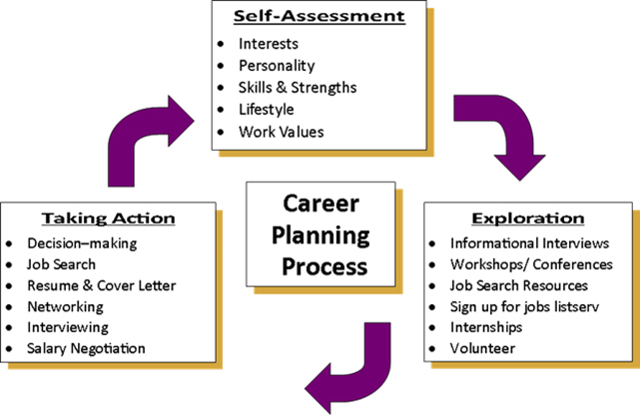
Summary: IDP
There are 5 steps involved in the process of developing your personal plan
Consider your strengths and development areas in defining your career goals
The template examples are guides you can use so feel free to modify them as applicable to your unique situation
Seek a second opinion on your document (from at least one of the following: a senior colleague, external individual within the field/area of research specialization and/or HR specialist).

Slide 33
Hands-on Exercises #1- Focus on project managements #2- Focus on Scientific writing

Slide 34
Hands-on exercise #1
NASA Project Management Challenge 2008
~ By NASA
One of the first major uses of project management as we know it today was to manage the United States space programme.
In 1986 the Challenger space shuttle disaster focused attention on risk management, group dynamics and quality management. Today NASA continues to focus on project management best practice to deliver major aerospace projects costing many billions of dollars. In this video, '2008 Project Management Challenge' NASA employees talk about the importance of good project management at the space agency.
https://www.projectsmart.co.uk/nasa-project-management-challenge-2008.php
A look at and discussion about successful project implementations

Slide 35
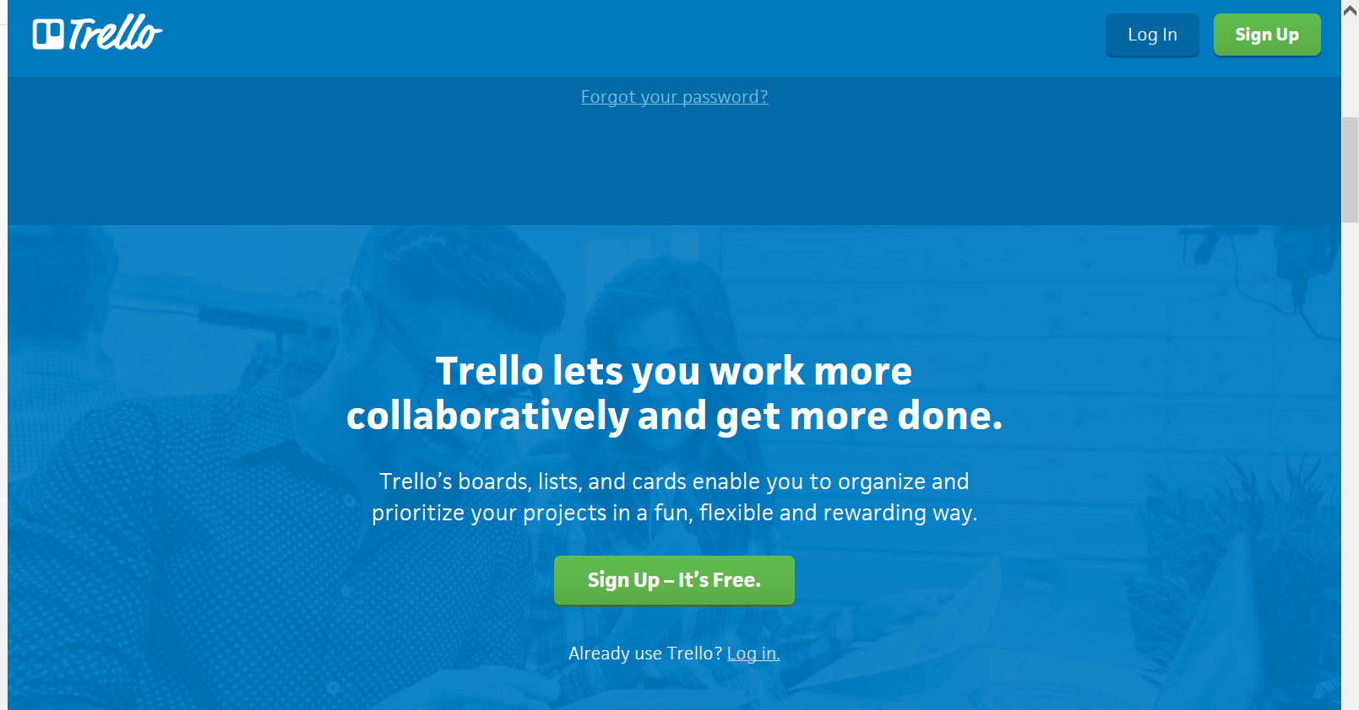
Project management Tools and resources
https://www.projectsmart.co.uk/communication-is-key-getting-everyone-in-the-loop.php
http://www.businessperform.com/project-management/project_management.html
https://www.projectsmart.co.uk/pdf/what-a-heart-surgeon-could-learn-from-a-project-manager.pdf
https://www.projectsmart.co.uk/pdf/who-is-the-project-manager.pdf
Tools: https://www.projectsmart.co.uk/tools.php
Example: Microsoft Sharepoint, Trello, others....

Slide 36
Exercise #1 discussion points
What role does the project manager play?
Do you consider yourself to be a project manager?
How many projects have you handled successfully?
What processes are you using for your projects? (agile, etc.)
What types of tools are you currently implementing for your projects?
How many people do you normally have to manage at a time for a given project?

Slide 37
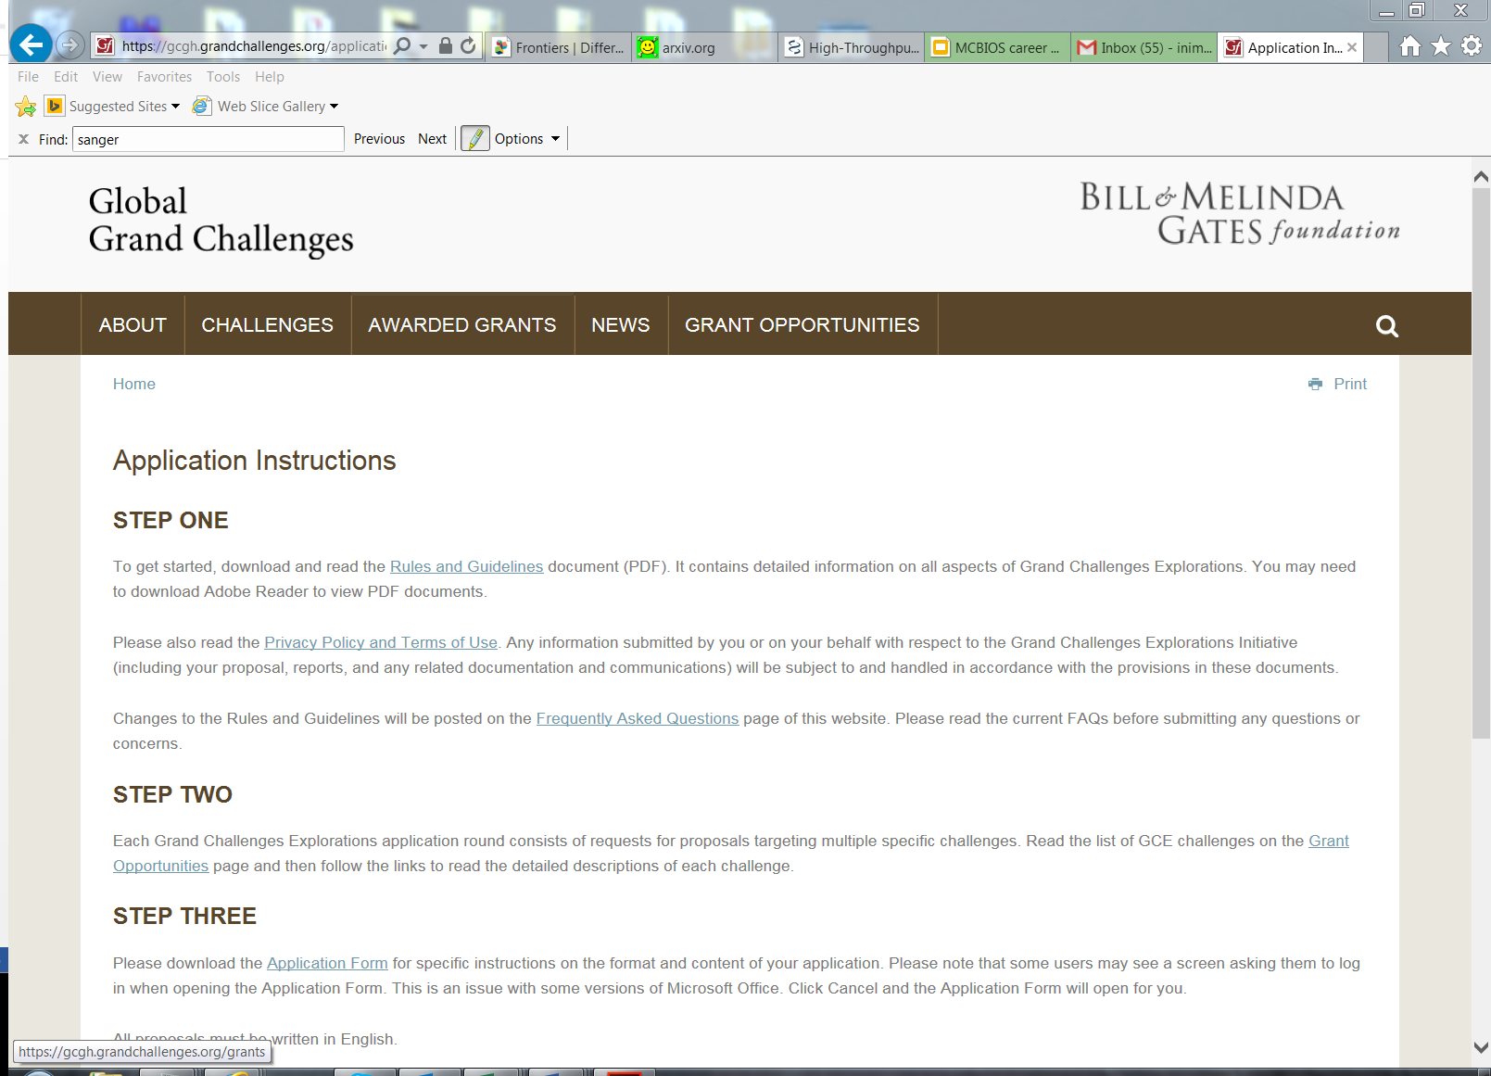
Hands-on exercise #2
A look and discussion about grant applications and reading through examples of successfully awarded grants.
Discussion files can be accessed at: https://www.niaid.nih.gov/grants-contracts/sample-applications

Slide 38
Exercise #2 discussion points
What are some of the identifiable traits for the successful grant award?
What are some benefits of the research approach in the award application?
Were there any weaknesses in the award?
How does your research area differ or compare to the area in the award application?
What types of things would you as a reviewer look for in an award application?

Slide 39

Summary
Career planning is an important step towards professional growth
Multiple avenues exist for networking and development
Various options are available to those in the Bioinformatics and Computational fields
Seek out the resources provided here as well as locally on campus or at nearby biotech companies
Get involved in meet-up groups, and/or interest groups in unrelated areas to your work (research area or expertise)

Slide 40
Q&A additional discussions post-workshop survey

Slide 41
References
References covered in the workshop:
http://slideplayer.com/slide/3887581/
https://www.projectsmart.co.uk/communication-is-key-getting-everyone-in-the-loop.php
http://www.businessperform.com/project-management/project_management.html
https://www2.deloitte.com/content/dam/Deloitte/global/Images/infographics/lifesciences-healthcare/lshc-2018-global-lifescience-outlook-infographic.pdf
https://www.careeronestop.org/toolkit/careers/occupations/occupation-profile.aspx?keyword=Computer Science Teachers, Postsecondary&onetcode=25102100&location=TEXAS
Data analysts vs Data Scientists:
https://www.youtube.com/watch?v=_Vi9W_2cxYA
https://www.youtube.com/watch?v=kNnFA5hxI2Q
References not covered in the workshop but worth looking at online:
http://slideplayer.com/slide/3887581/
https://environment.yale.edu/careers/resources/phdpostdoc/
www.careerbuilder.com
www.indeed.com
www.higheredjobs.com
https://www.youtube.com/watch?v=0277AINk5xk
https://www.youtube.com/watch?v=Eq1df8rUrog
https://www.youtube.com/watch?v=HSWJad7PRas
https://www.youtube.com/watch?v=MTXL7EIBwIg

